Slide 1
PopulationGrid Adaptive Therapy Modeling
Rafael Bravo, Saanvi Prasad, Mark Robertson-Tessi, Alexander Anderson

Slide 2
Res
Epithelial
Sen
Resource Dependent Proliferation
Glucose
Drug Kill
Michaelis Menten Consumption
Michaelis Menten Consumption
Drug
Influx
From Blood
Endothelial

Slide 3
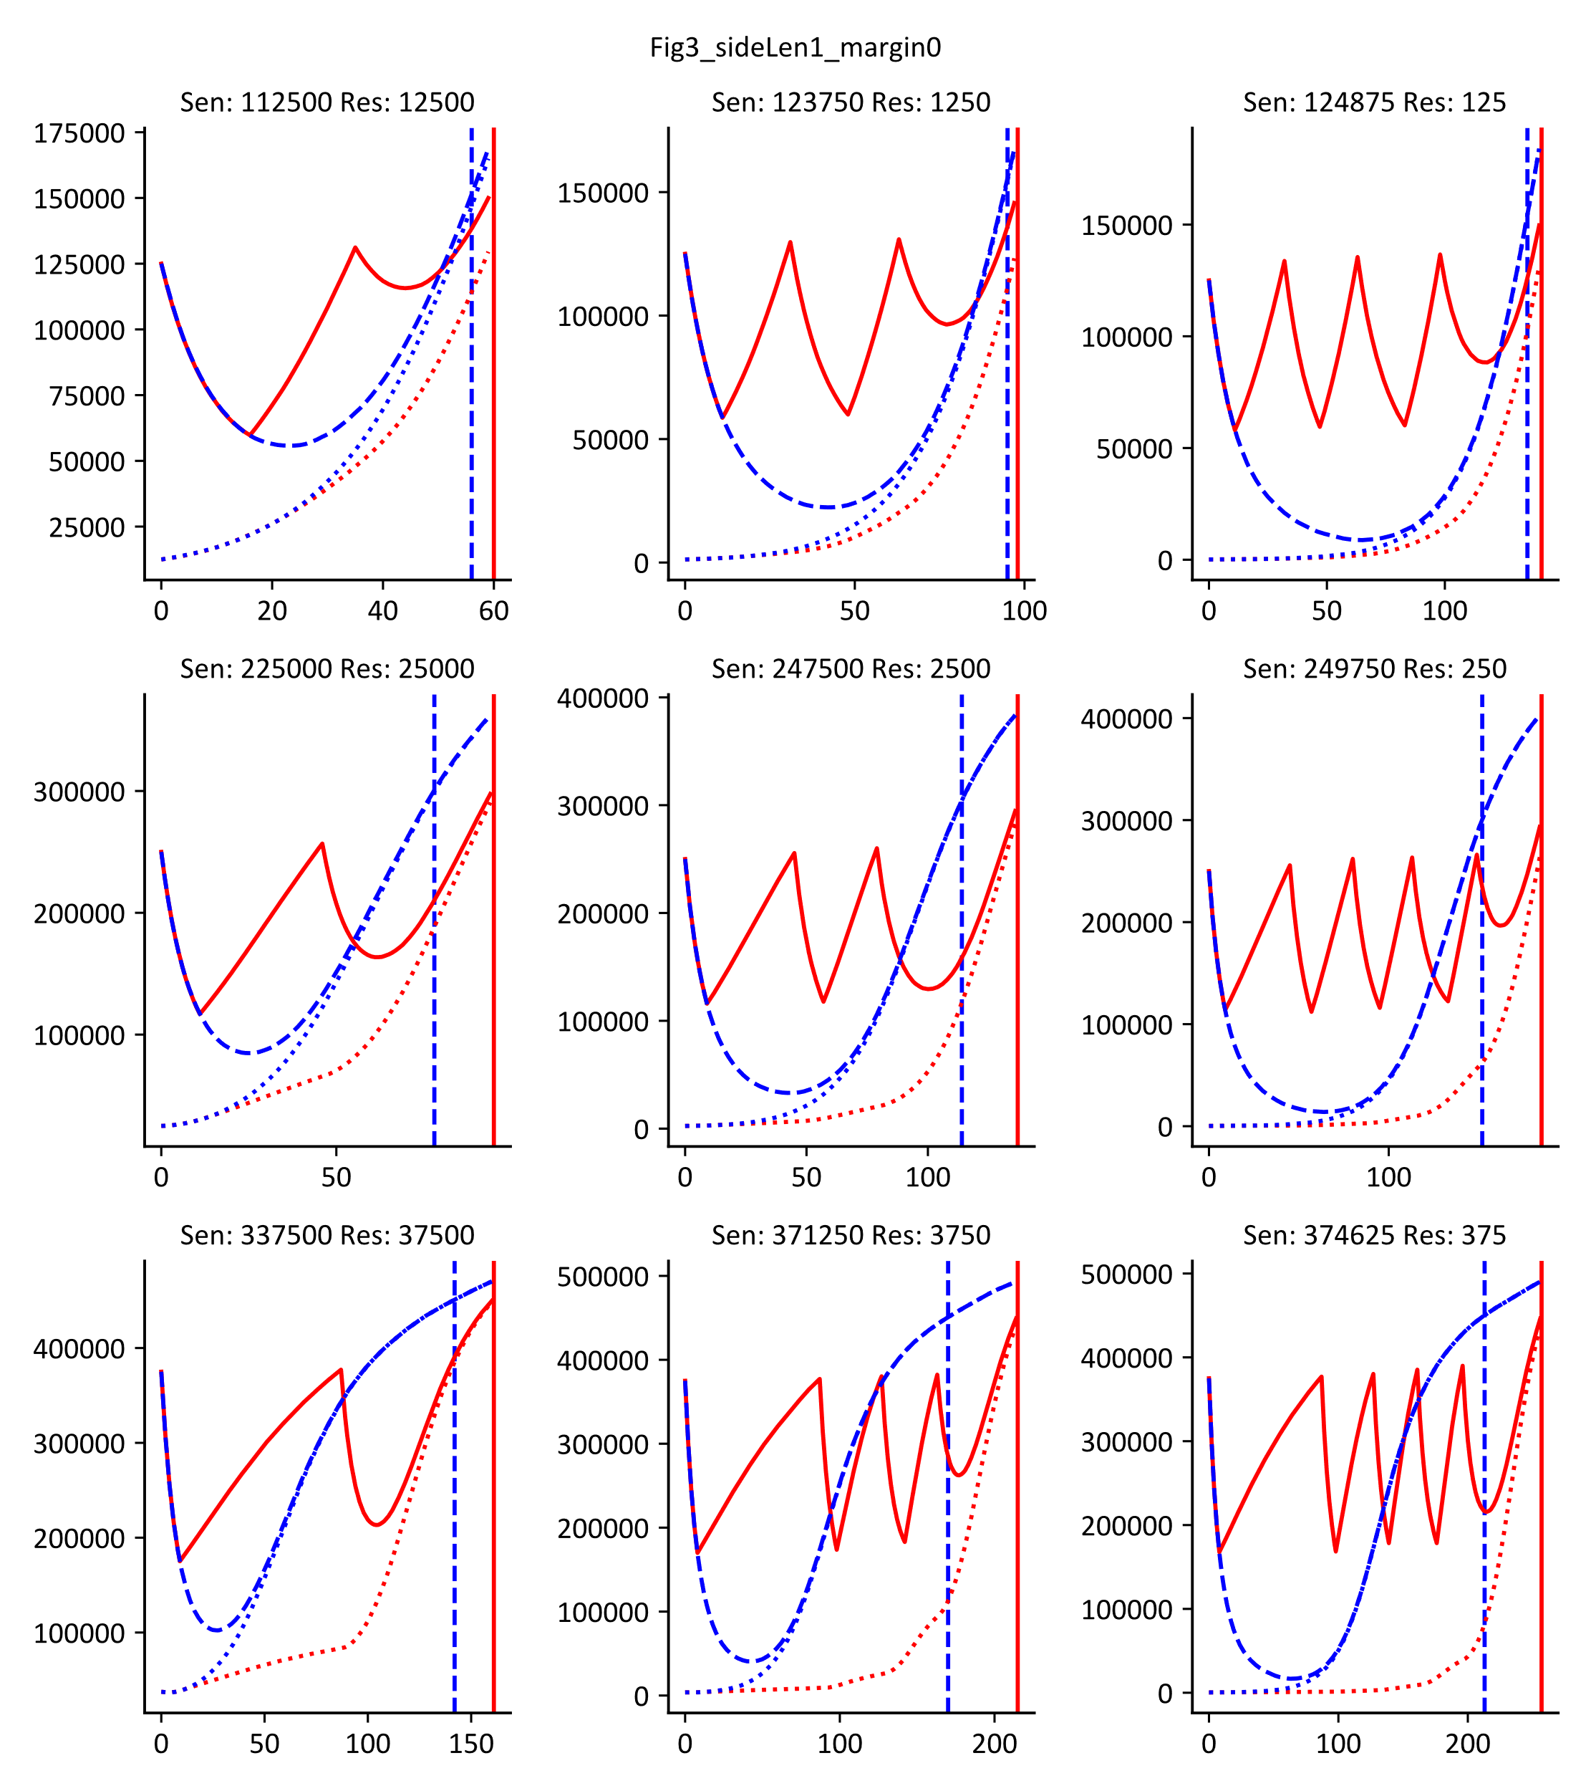

Drug
Res.
Sens.
Adaptive Therapy
Gluc.
Endo
Epi
Drug
Res.
Sens.
Constant Therapy
Gluc.
Endo
Epi

Slide 4
Varying Initial Sensitive and Resistant Populations
Drug
Res.
Sens.
Gluc.
Endo
Epi
Drug
Res.
Sens.
Gluc.
Endo
Epi
Drug
Res.
Sens.
Gluc.
Endo
Epi

Slide 5
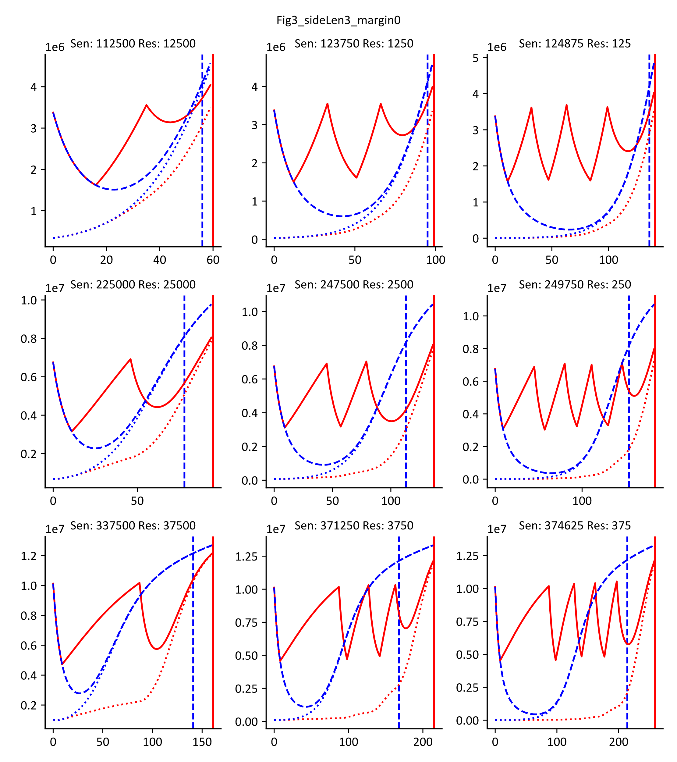
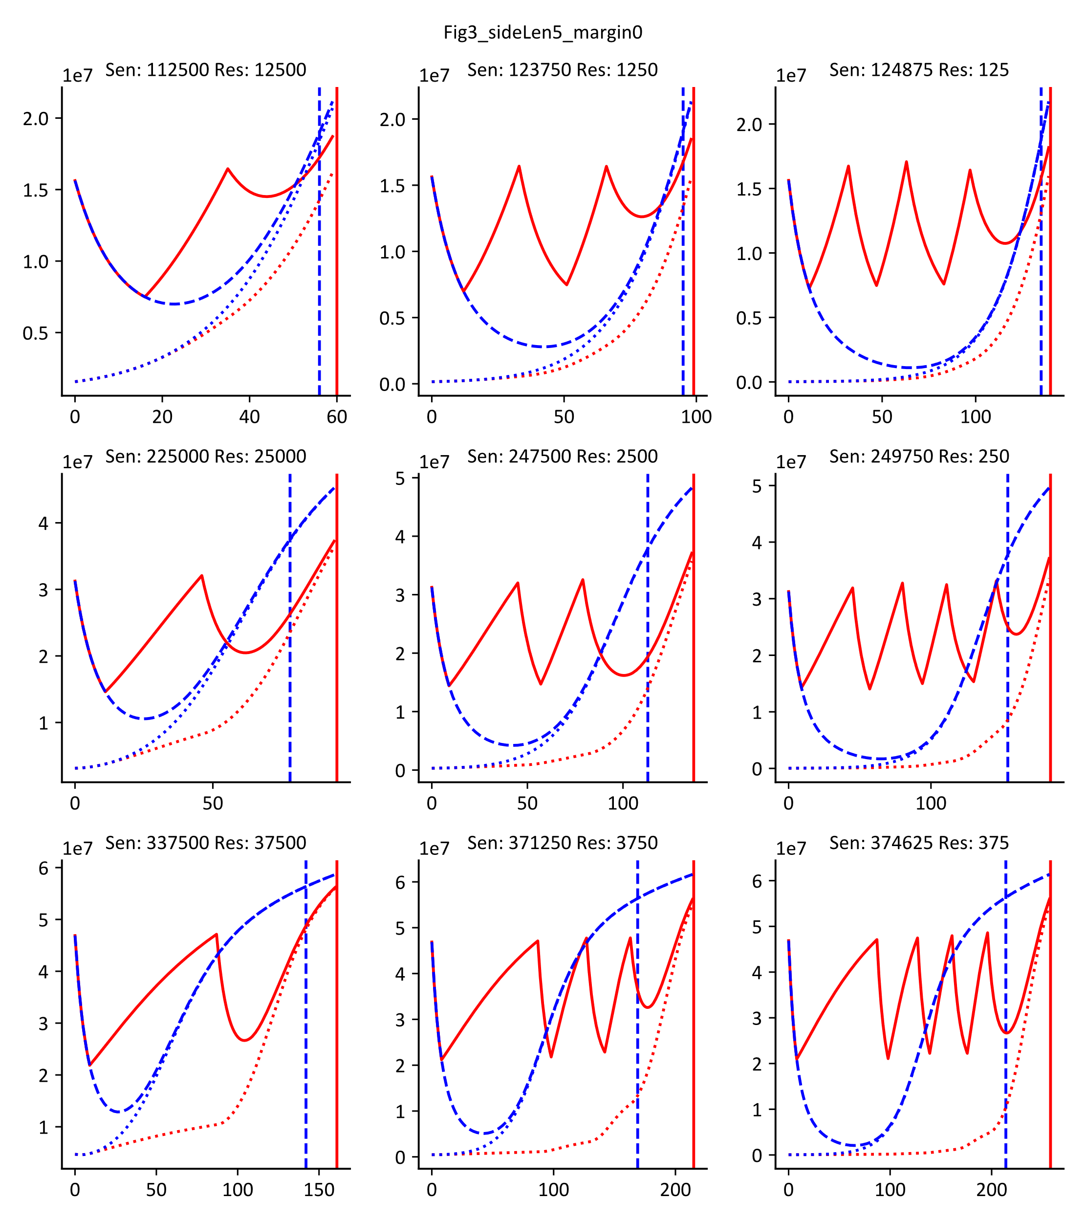


Varying Domain Size Doesn’t Affect Outcome

Slide 6
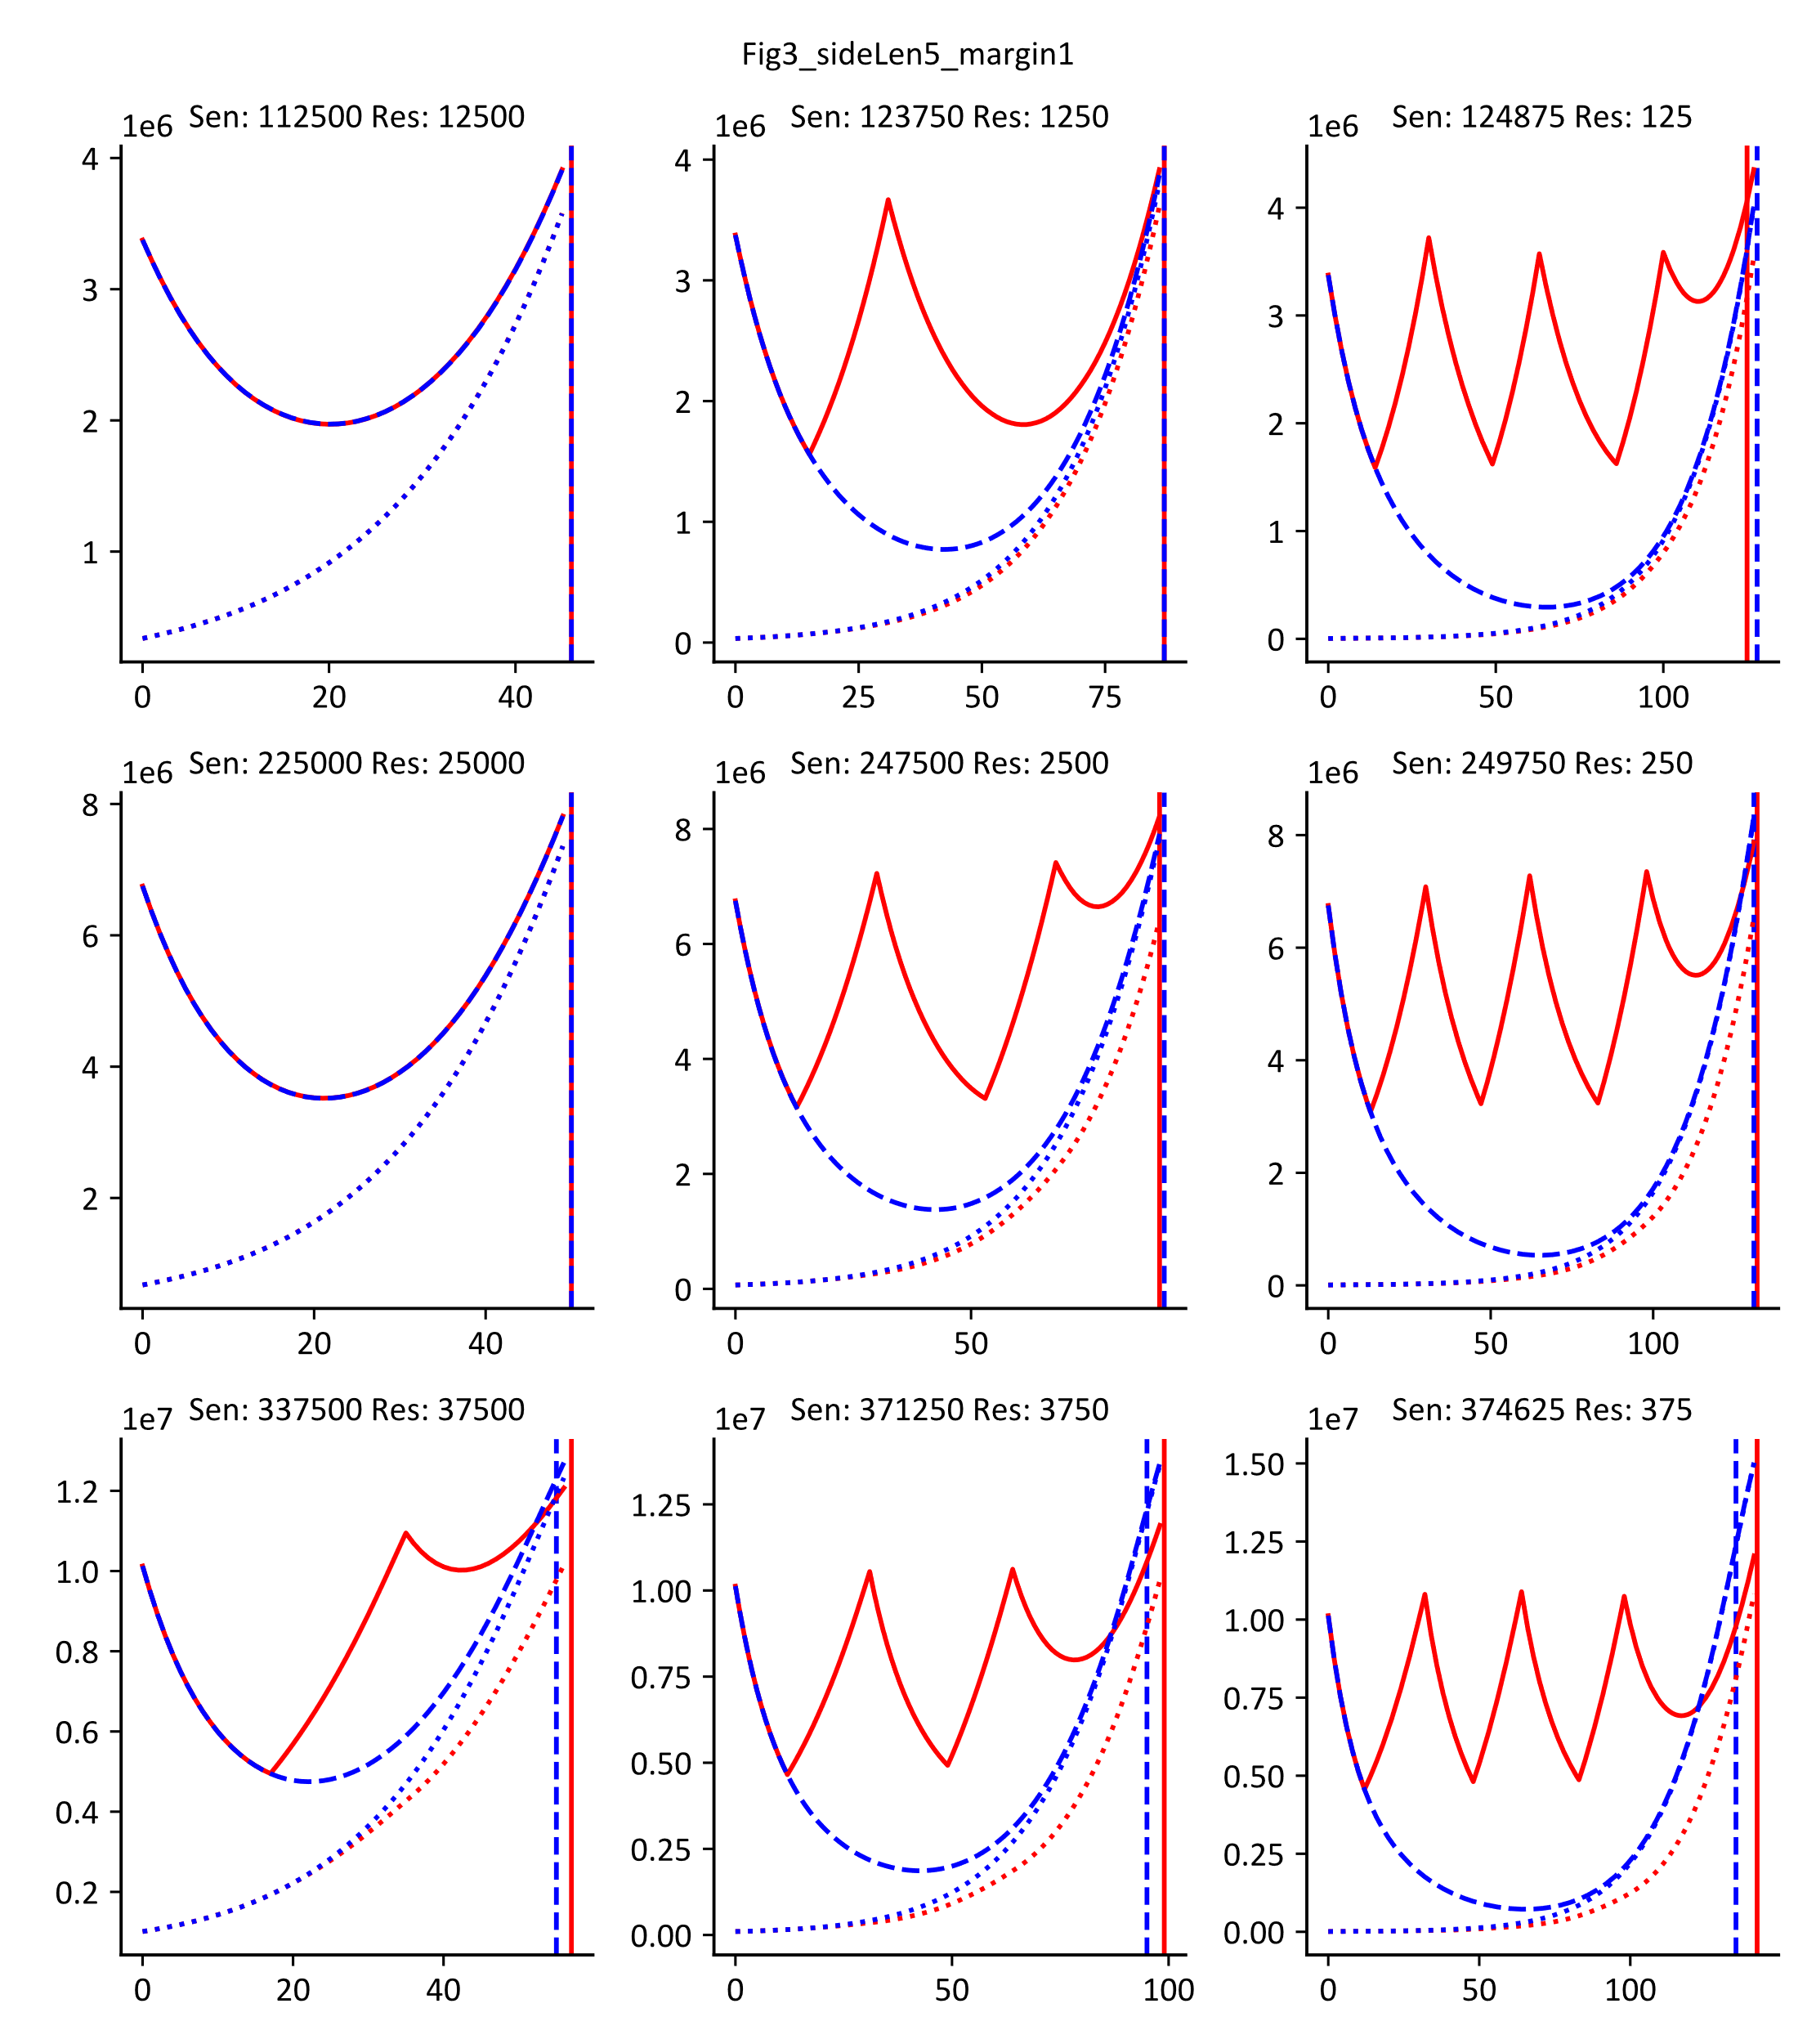
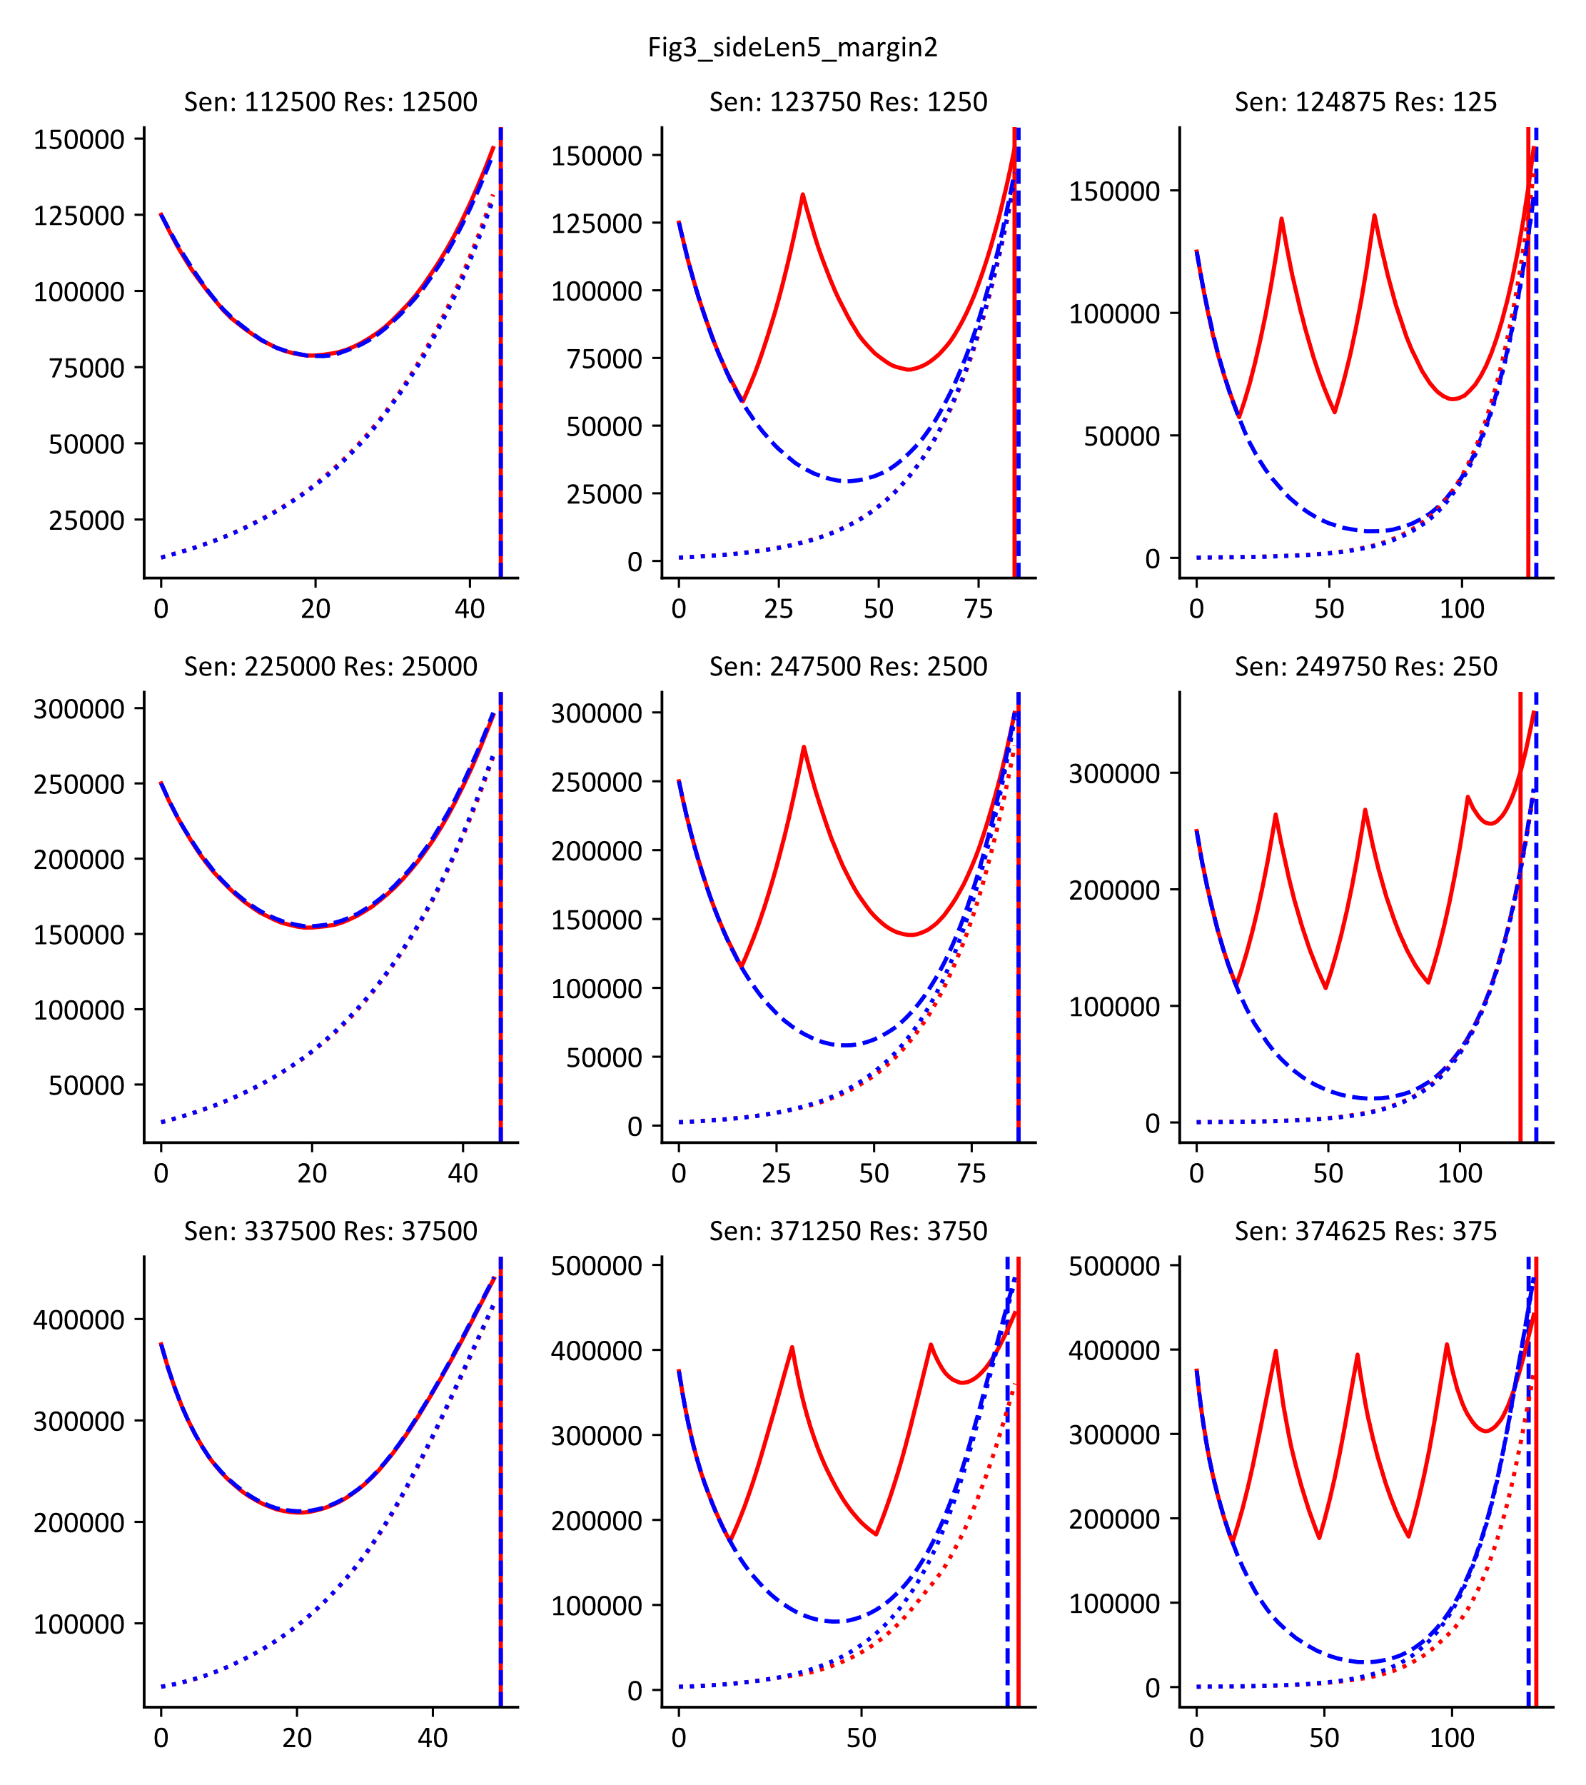
Varying Initial Tumor Margin Affects Outcome

Slide 7
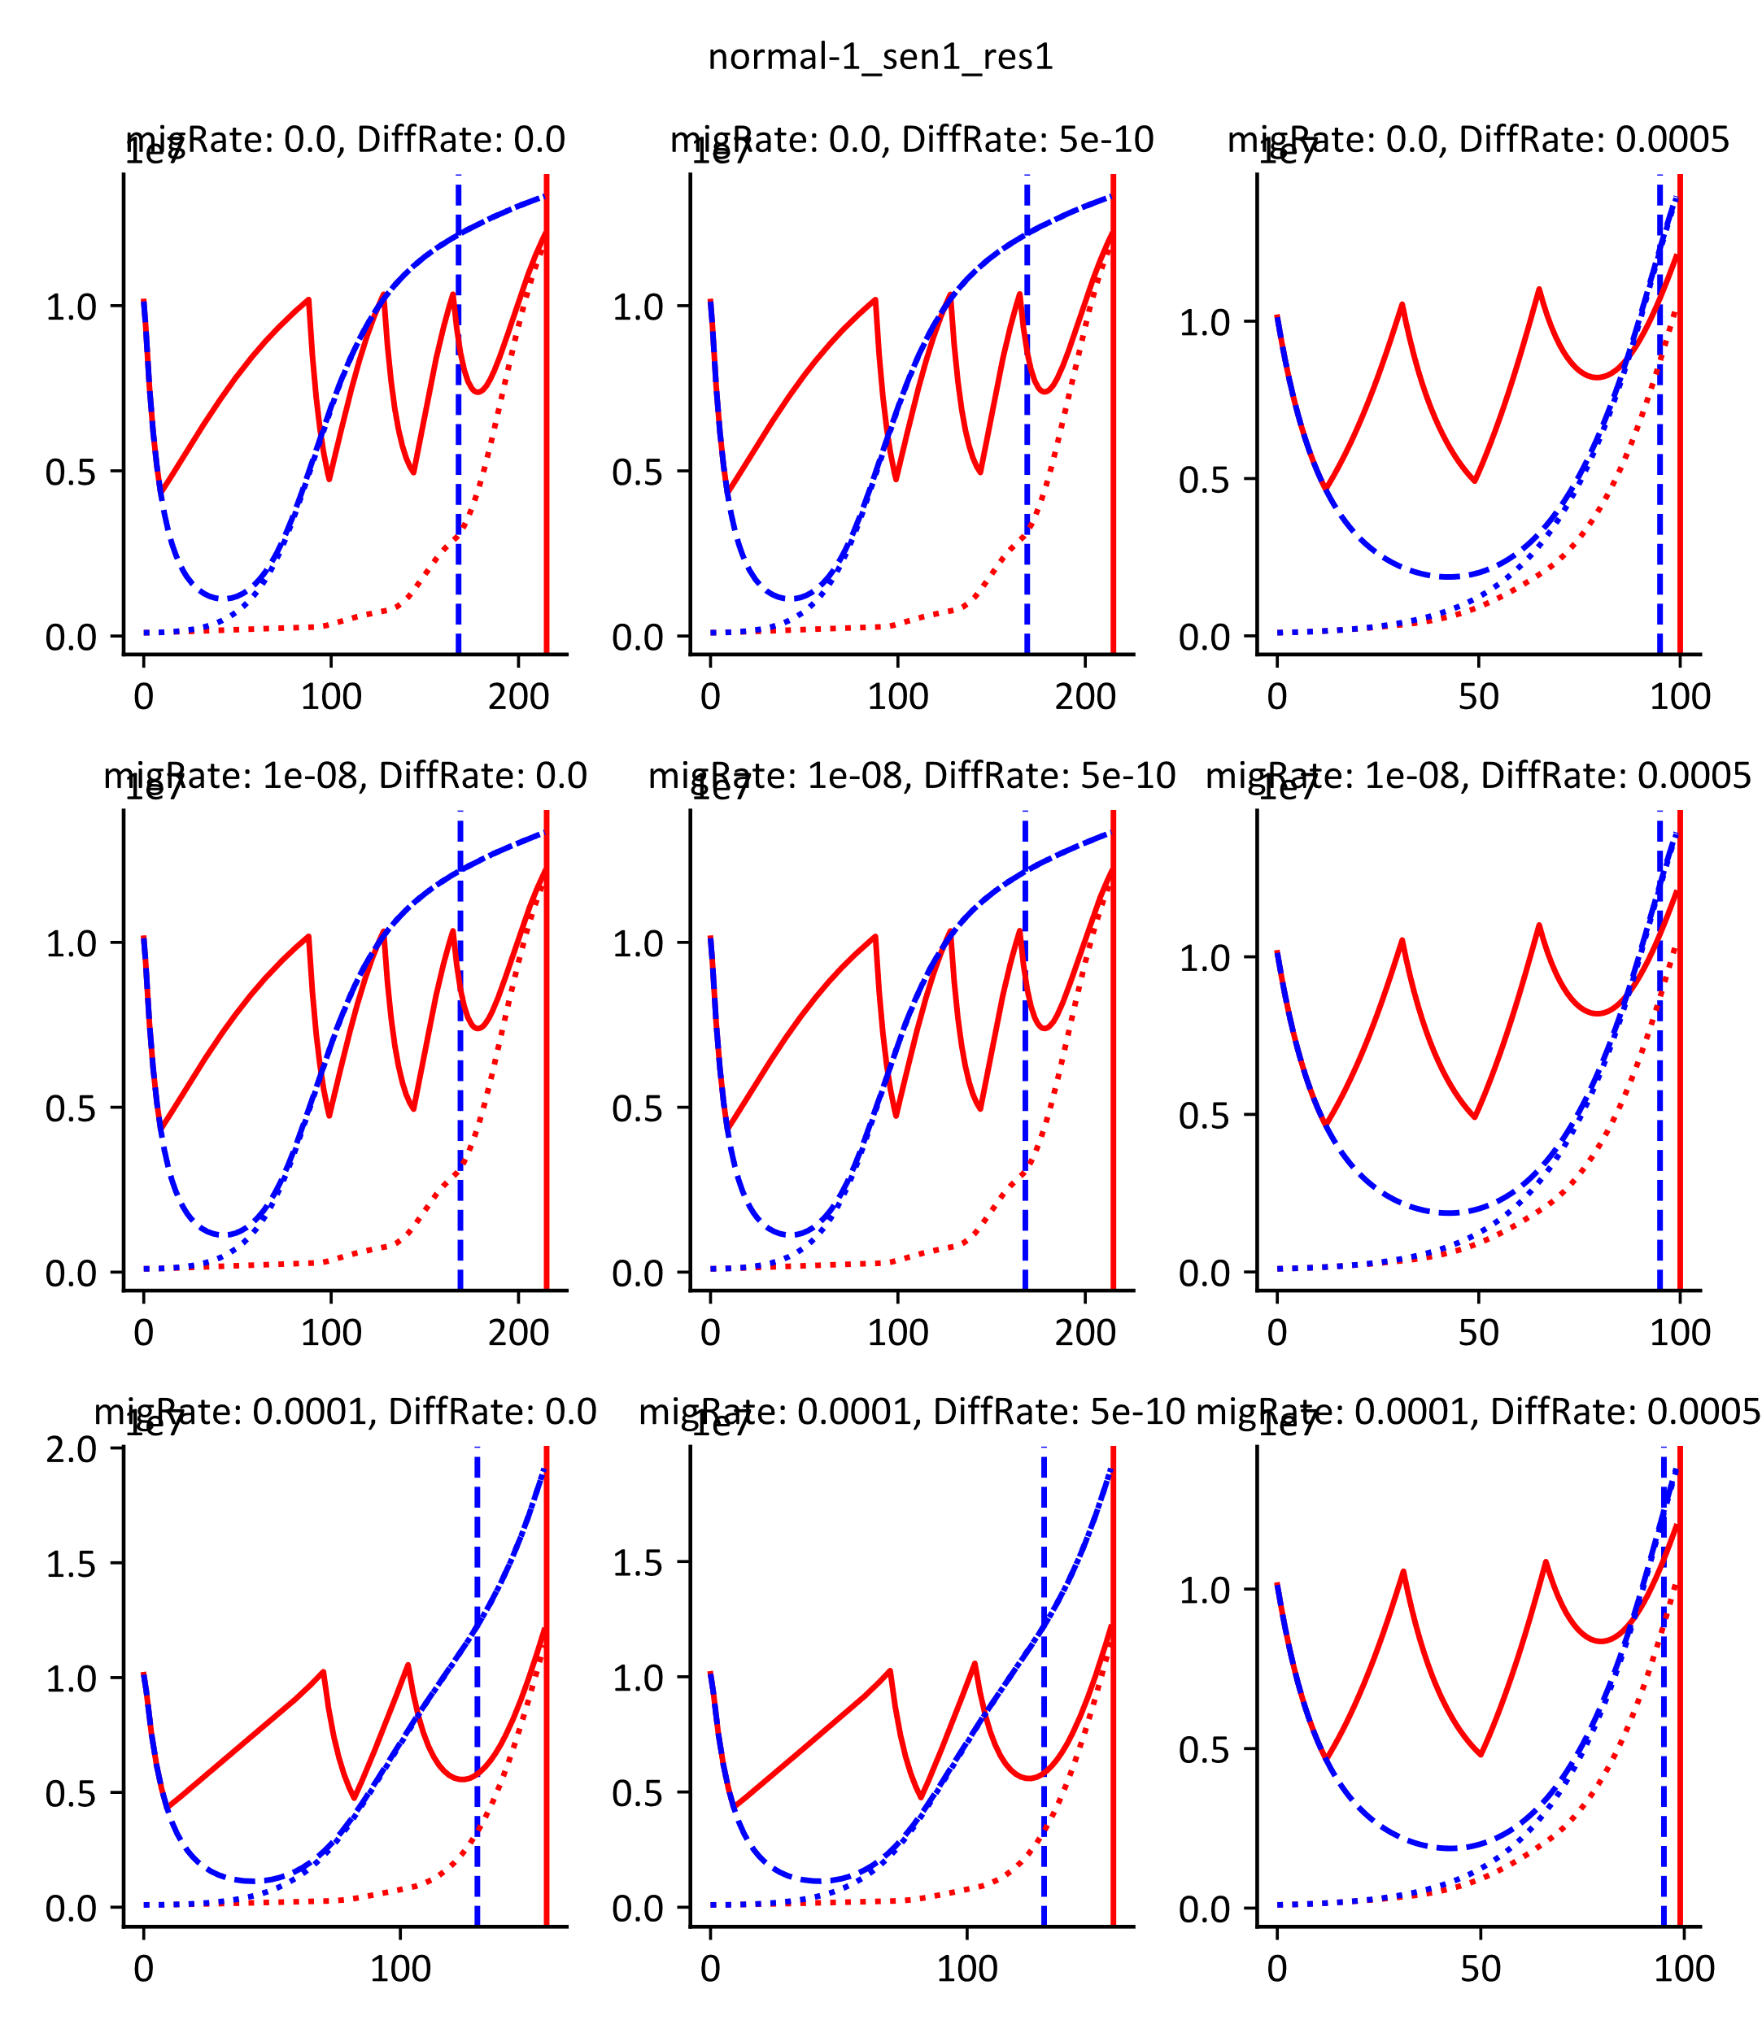
Why Does Varying Margin Affect Outcome?

Slide 8
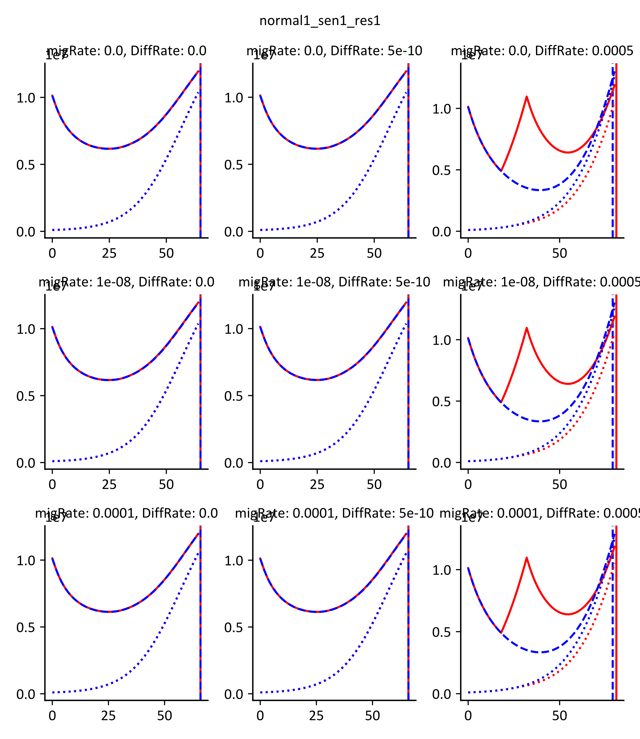
Introducing Normal Tissue Gap For Tumor Makes AT nearly impossible

Slide 9
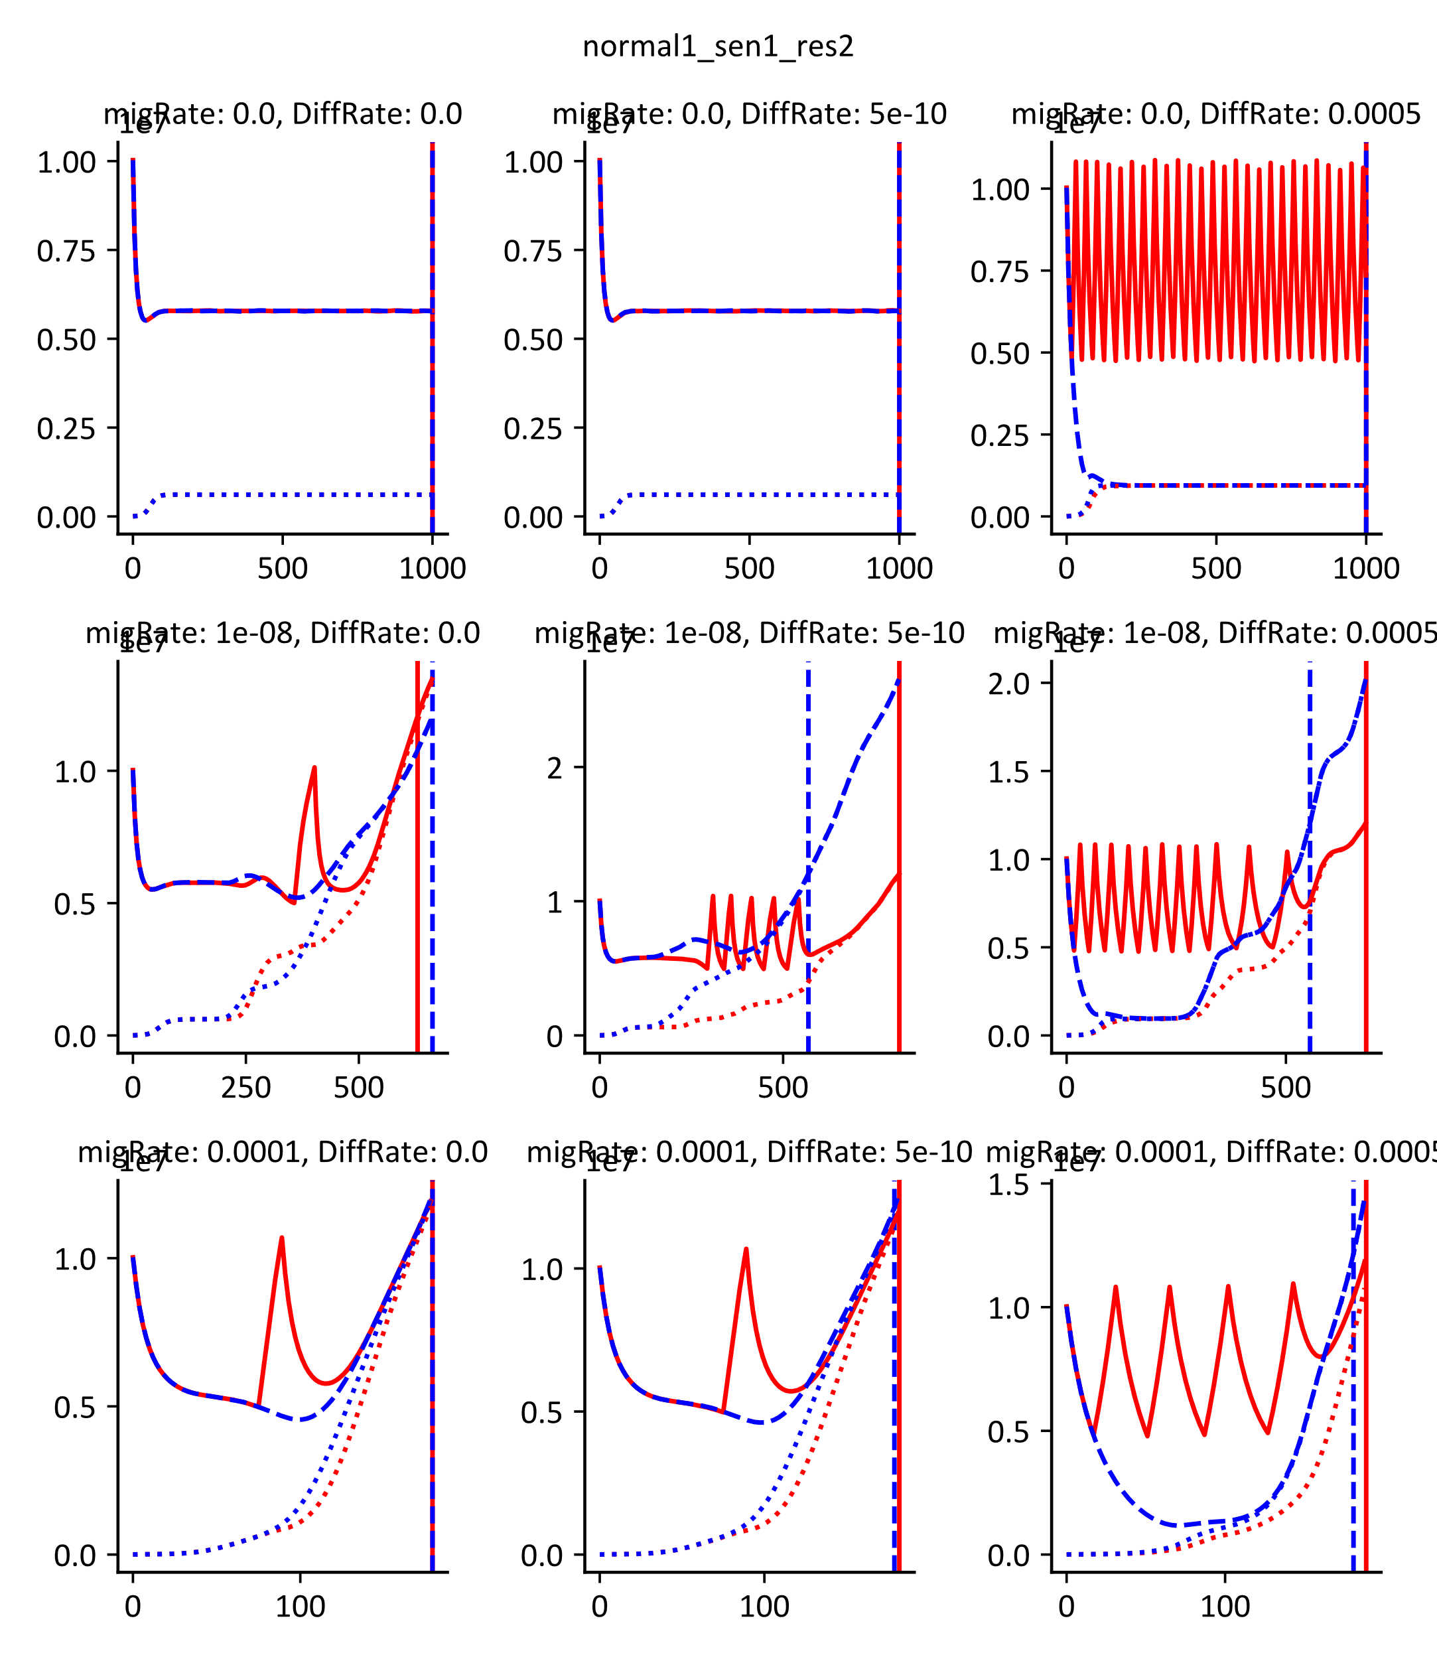
Competitive Release Makes A Difference for slow migration rates

Slide 10
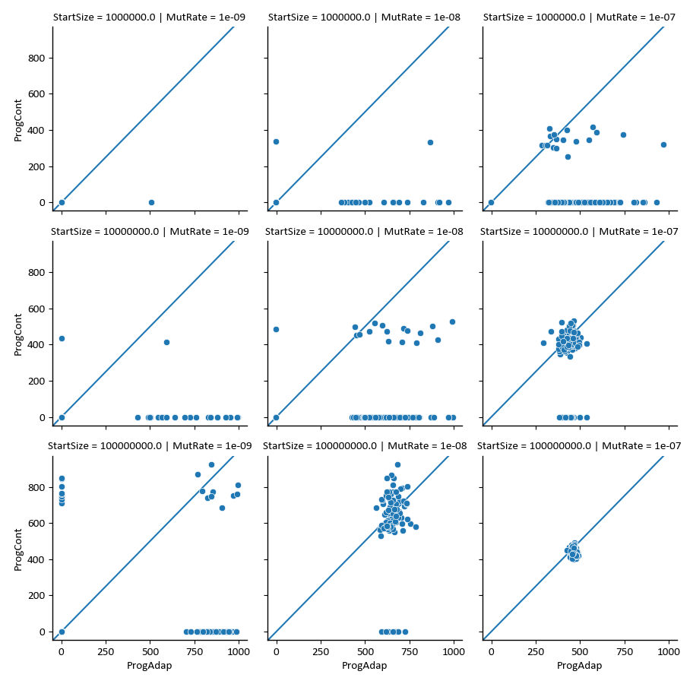

Slide 11
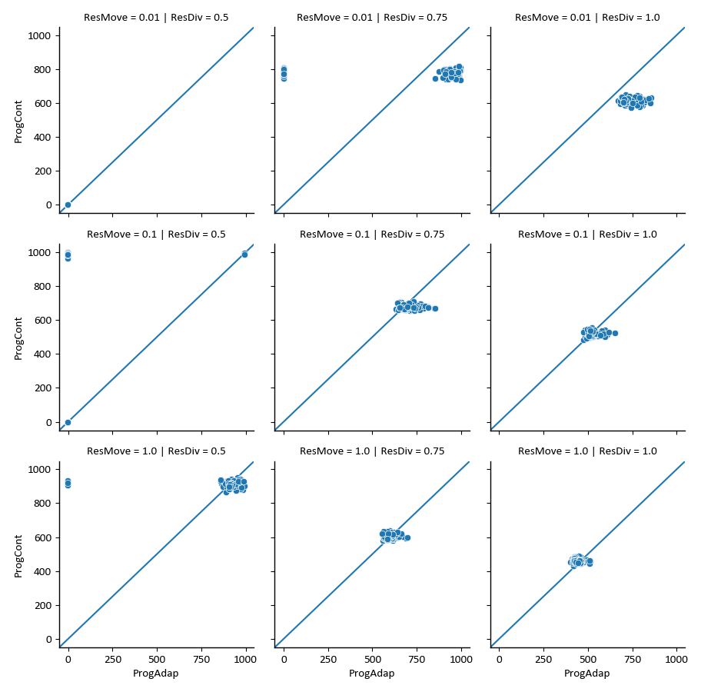



Slide 12





















Slide 13
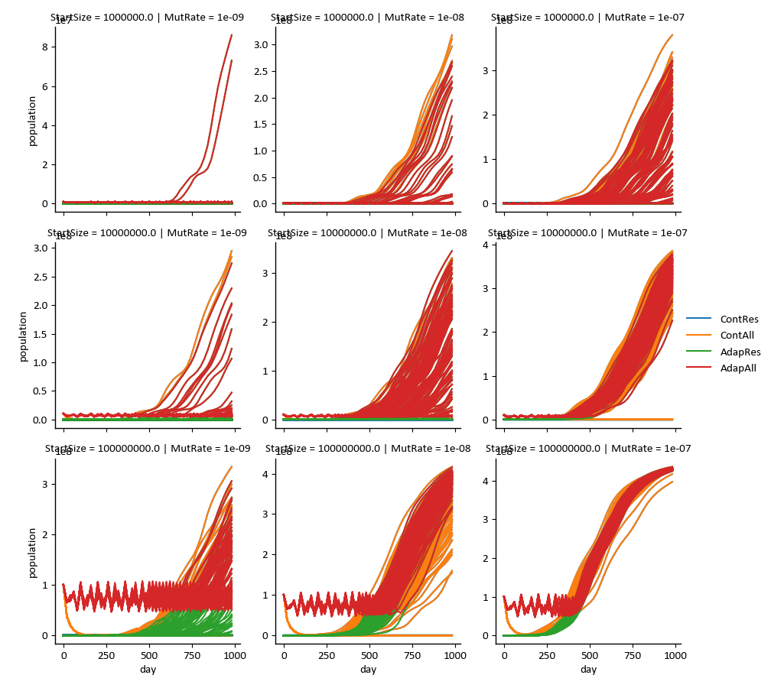

Slide 14
